Slide 1


DSM2 Website
DSM2 Cool Tip
http://baydeltaoffice.water.ca.gov/modeling/
deltamodeling/models/dsm2v8/dsm2.cfm
Bay Delta Office website ⇨ Modeling Support ⇨ Delta Modeling ⇨Delta Evaluation Tools ⇨ Delta Simulation Model II (DSM2)
DSM2v8

Slide 2
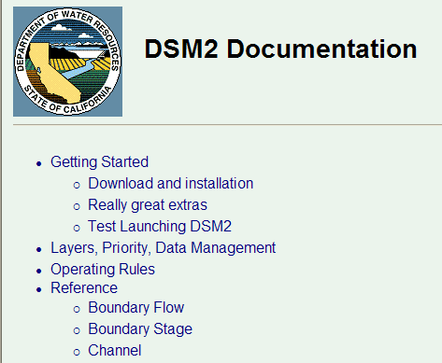
DSM2 Documentation
DSM2 Cool Tip
⇨ All Programs ⇨ DSM2v8 ⇨ DSM2_documentation

Slide 3

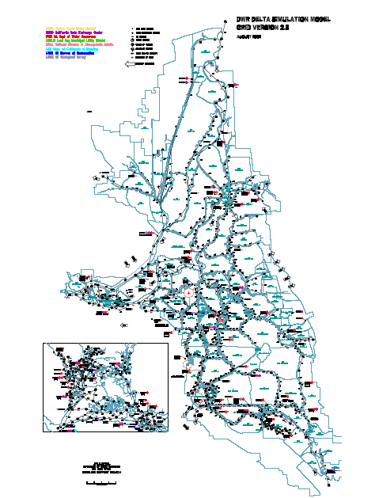
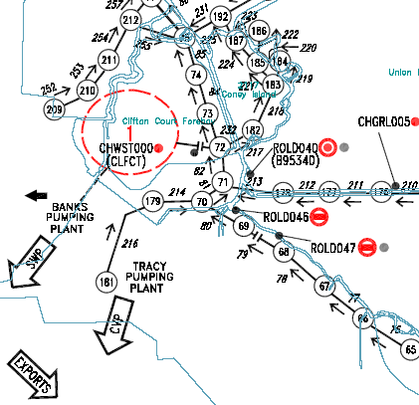
DSM2 Grid
DSM2 Cool Tip
C:\delta\dsm2_v8\documentation\DSM2_Grid2.0.pdf

Slide 4

Annual Reports to SWRCB
DSM2 Cool Tip
http://baydeltaoffice.water.ca.gov/modeling/deltamodeling/annualreports.cfm
QUAL dispersion coefficients 2008 CH2
82-year planning tide 2007 CH4
SDIP gates 2006 CH6
PTM for fish entrainment 2006 CH10
Fingerprinting 2005 CH6
Net Delta Outflow calcs using DSM2 & CalSim 2003 CH4
Adjusted astronomical tide 2001 CH10
SWRCB = State Water Resources Control Board SDIP=South Delta Improvements Program
PTM = Particle Tracking Model

Slide 5
dsm2_tidy
DSM2 Cool Tip
Although spaces or tabs can be used in DSM2, columns with spaces tend to look better when opened in a different viewer.
The dsm2_tidy utility cleans up columns and spaces.
Type dsm2_tidy --help at a command prompt for more info.

Slide 6
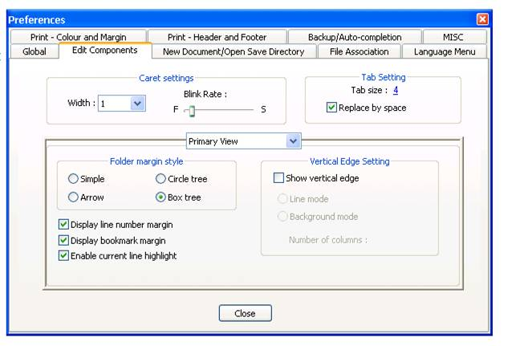
Notepad ++ setting to replace tabs with spaces
DSM2 Cool Tip

